Slide 1
Fine-mapping GWAS loci

Slide 2
Characterising GWAS loci
GWAS have been successful in identifying loci contributing to complex disease.
Loci typically characterised by common variants that are in strong LD with each other, and consequently have similar strength of association.
How can we identify the causal variant(s) and causal gene(s)?
Provides insight into upstream biology (e.g. causal variants tend to map to enhancers in a specific tissue) and downstream biology (e.g. effect of variant on disease is mediated through a specific gene).

Slide 3
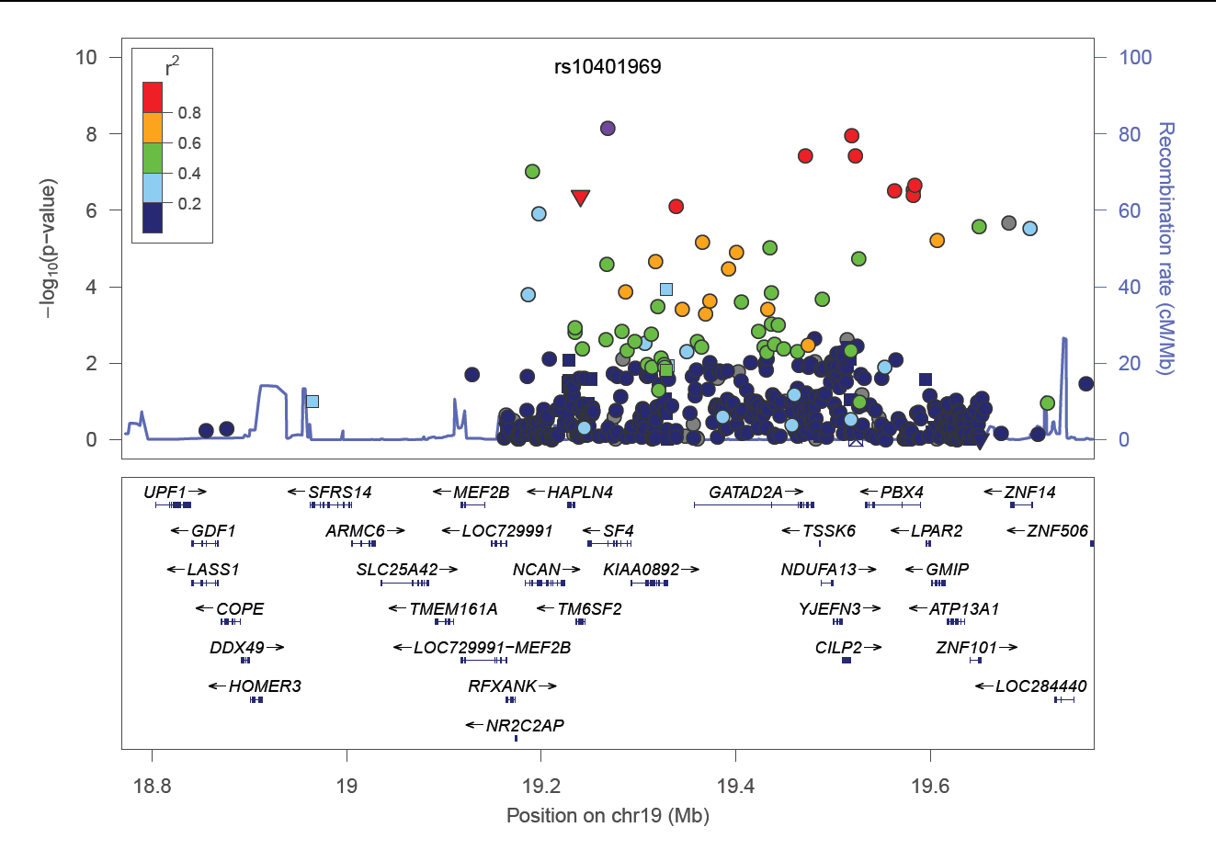
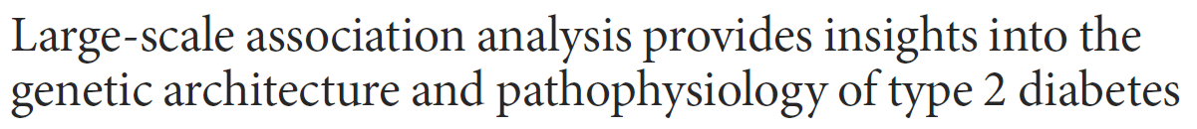
CILP2 locus and type 2 diabetes

Slide 4
Do we have evidence of multiple causal variants at a locus?
Typical to first dissect association signals at GWAS loci that reflect different underlying causal variants.
Can be achieved through conditional analysis: include genotypes at SNP with strongest association signal as a covariate.
Iterative “forward” selection: add SNP with strongest association signal as additional covariate until there is no residual association.
Approximate conditional analyses implemented in GCTA software:
Individual level genotype data not required: association summary statistics.
Reference genotype dataset for LD: correlation between test statistics in joint model.
Implements backward selection to identify index SNPs for each distinct association signal.

Slide 5
Dissecting T2D association signals
Total of 27,206 T2D cases and 57,574 controls from 23 studies of European ancestry, genotyped with the Metabochip.
Custom iSELECT array containing ~195K SNPs, designed to support large-scale follow-up of putative associations for T2D and other metabolic and cardiovascular traits.
High-density coverage of variation from 1000 Genomes Project pilot data in 180 fine-mapping regions overlapping 39 established loci for T2D susceptibility.
Evaluate the evidence for multiple signals of association at established T2D susceptibility loci.

Slide 6
Dissecting T2D association signals
Approximate conditional analysis undertaken using the GCTA software using 3,298 cases and 3,708 controls from GoDARTS as reference.
In silico replication of association signals in an additional 19,662 T2D cases and 115,140 controls of European ancestry (combined meta-analysis p<10⁻⁵).
Confirmation of association signals through exact conditional analysis.

Slide 7
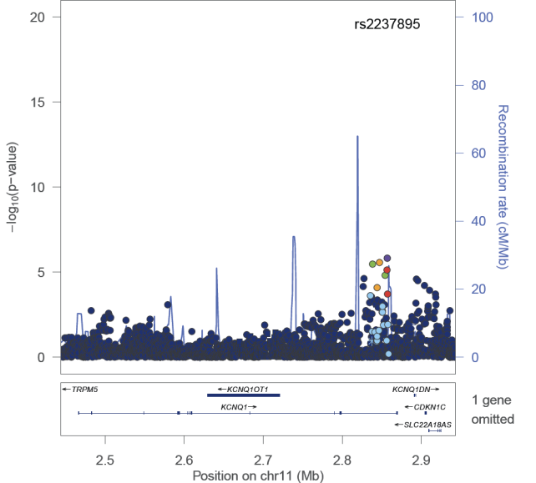
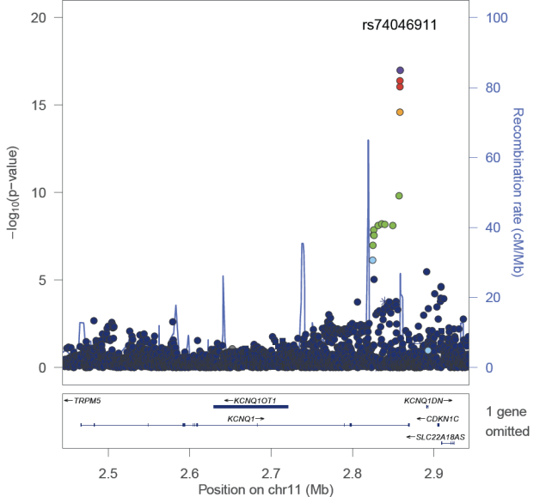
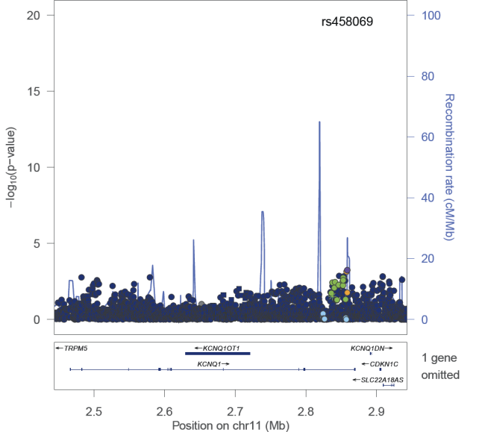
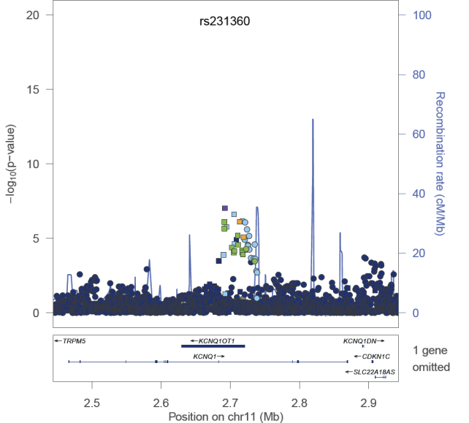
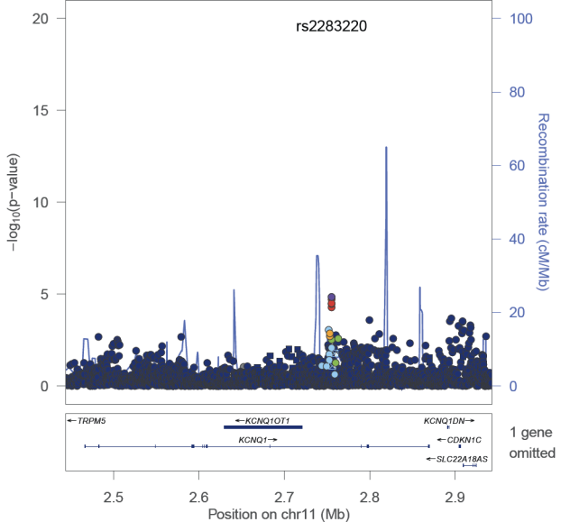
Five signals of association at KCNQ1
rs2237895
rs74046911
rs458069
chr11:2692322:D
rs2283220
Assume that each signal is driven by a different underlying causal variant.

Slide 8
Localisation of causal variants
Evaluate fine-mapping resolution on basis of statistical evidence of association by construction of “credible sets” of variants in each signal.
Posterior probability of “causality” for each variant.
Identify smallest set of variants that account for 95% (99%) of the probability of causality: 95% (99%) credible set.
Smaller credible sets (number of variants and/or genomic interval covered) correspond to greater fine-mapping resolution.

Slide 9
Posterior probability of causality
For each association signal, we require a Bayes’ factor in favour of association for each variant.
Can be obtained directly from SNPTEST.
Can be approximated on the basis of association summary statistics via Wakefield approach:
Effect size β and corresponding variance V.
Prior variance of effect size ω: typically taken to be 0.04 for binary traits.
Posterior probability of causality then given by:
Can incorporate prior probability of causality.

Slide 10
Alternative approaches to fine-mapping causal variants
Wakefield’s approach assumes a single causal variant: hence need for dissection of association signals via (approximate) conditional analysis.
Recent development of methods that allow for multiple causal variants at a locus: CAVIAR, PAINTOR, FINEMAP, SuSiE, and JAM.
Methods make use of association summary statistics and reference for LD between variants as the locus.
Developed in Bayesian framework: MCMC techniques to estimate posterior probability of causality for each variant.
Can incorporate prior of causality.

Slide 11
Trans-ancestry fine-mapping
Population 1
0 0.2 0.4 0.6 0.8 1
-log₁₀ p-value
r²
Assumption: causal variant is shared across populations

Slide 12
Trans-ancestry fine-mapping
Population 1
0 0.2 0.4 0.6 0.8 1
-log₁₀ p-value
r²
Assumption: causal variant is shared across populations

Slide 13
Trans-ancestry fine-mapping
Population 1
0 0.2 0.4 0.6 0.8 1
-log₁₀ p-value
r²
Population 2
-log₁₀ p-value
Assumption: causal variant is shared across populations

Slide 14
Trans-ancestry fine-mapping
Population 1
0 0.2 0.4 0.6 0.8 1
-log₁₀ p-value
r²
Meta-analysis
Population 2
-log₁₀ p-value
-log₁₀ p-value
Assumption: causal variant is shared across populations

Slide 15
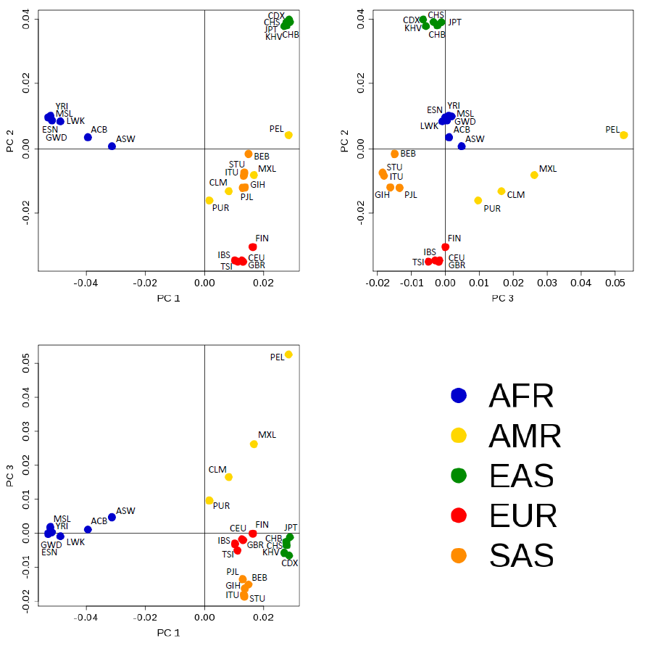
Trans-ancestry meta-regression
Important to model potential heterogeneity in allelic effects at a SNP between ancestry groups: can arise from interactions with environmental factors that differ between populations or with other SNPs that differ in allele frequencies between populations.
Meta-regression can be used to model heterogeneity due to a “confounder” that differs between GWAS as a covariate.
Principal components analysis can be used to derive “axes of genetic variation” that explain genetic differences between populations.
MR-MEGA uses axes to model heterogeneity in allelic effects between GWAS: those that are genetically dissimilar are more likely to have heterogeneous effects.
https://genomics.ut.ee/en/tools/mr-mega

Slide 16
Fine-mapping four T2D susceptibility loci
Meta-analysis of 19 GWAS of 22,086 cases and 42,539 controls from European, South Asian, East Asian, Hispanic and African-American ancestry groups by T2D-GENES Consortium.
Four T2D loci: CDKAL1, KCNQ1, CDKN2A-B, and IGF2BP2:
Strongest signals of association in most ethnic groups.
Evidence of differences in association signals and patterns of linkage disequilibrium between ethnic groups.
High-density imputation to 1000 Genomes reference panels provides near complete coverage of common and low-frequency variation.
Comparison of 99% credible sets from ancestry-specific and trans-ethnic meta-analysis.

Slide 17
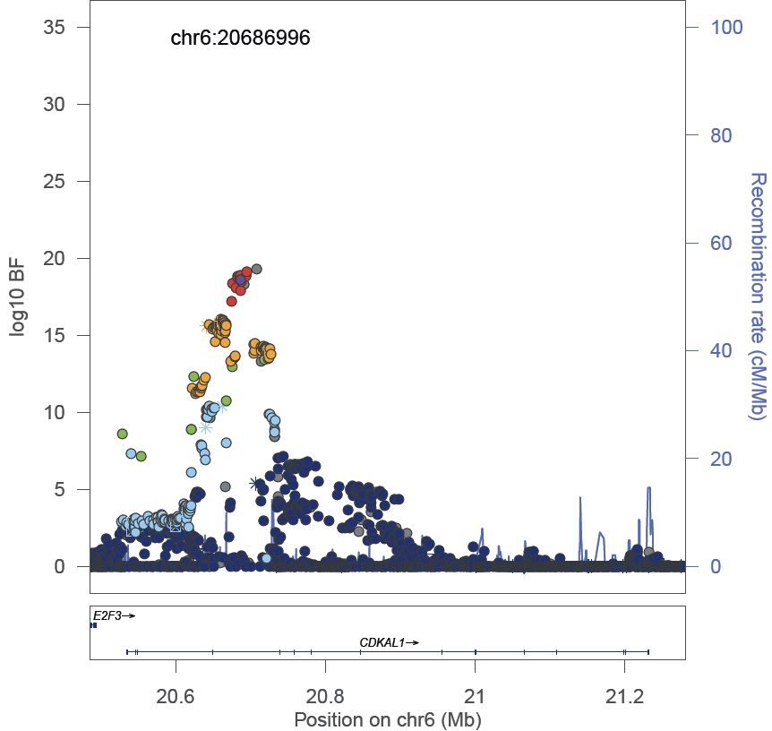
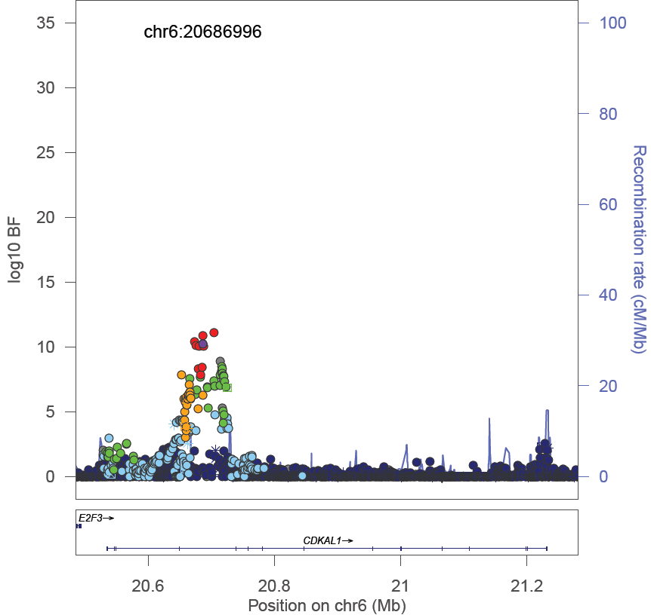
Improved fine-mapping at CDKAL1
East Asian
clade
European, South Asian
and Hispanic clade
rs9368222
99% credible set: 15 SNPs, 34.4kb
rs9368222
99% credible set: 8 SNPs, 40.4kb

Slide 18
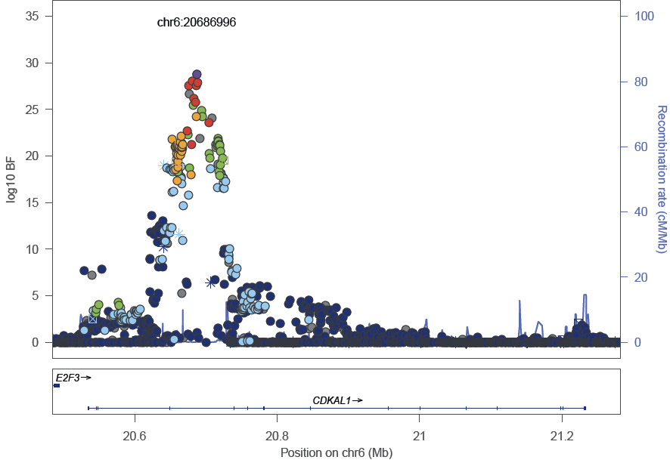
Improved fine-mapping at CDKAL1
Lead SNP: rs9368222
99% credible set: 5 SNPs, 12.3kb

Slide 19
A note on trans-ancestry fine-mapping
Methods that do not assume a single causal variant cannot be directly applied for trans-ancestry fine-mapping.
Methods require specification of matrix of LD between variants: but LD varies from one ancestry group to another!
PAINTOR can be used by specifying ancestry-specific association summary statistics and LD matrices.

Slide 20
Expression quantitative trait loci
Colocalistion of putative causal variants with expression quantitative trait loci (eQTLs) can provide insight into downstream biology.
Causal variant impacts trait/disease through regulation of gene expression.
Regulation of gene expression can be tissue specific or ubiquitous across tissues: important to have trait/disease relevant tissues.
Data available from GTEx Project (multiple tissues) and GEUVADIS (lymphoblastoid cell lines): other cell-type specific data resources.

Slide 21
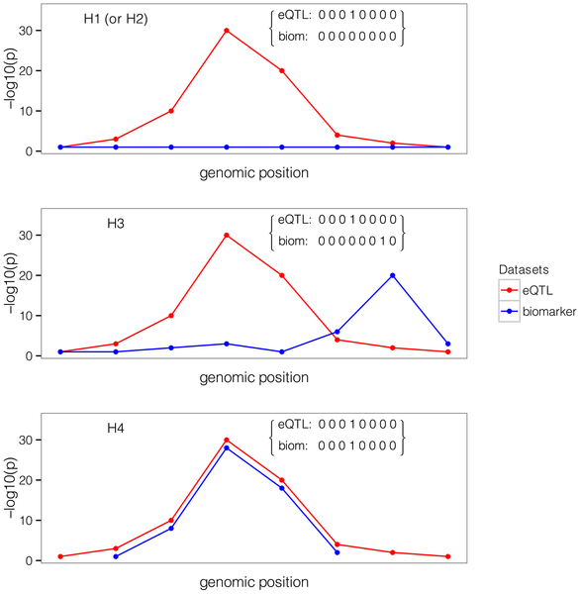
Colocalisation
Compare patterns of association for trait and eQTL.
Model H1: no association with trait.
Model H2: no association with eQTL.
Model H3: association signals with trait and eQTL that are not coincidental.
Model H4: association signal with trait and eQTL that are coincidental.
COLOC calculates the posterior probability for each model on the basis of association summary statistics: accounts for LD between variants.

Slide 22
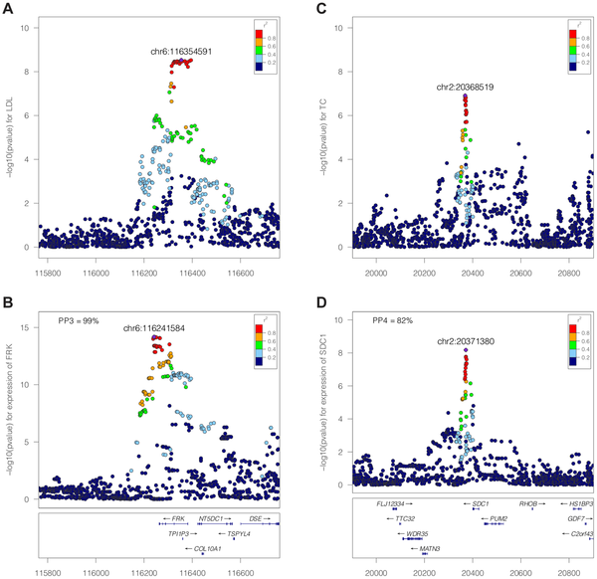
Lipids and LCL expression

Slide 23
Summary
Often difficult to determine causal variant at a GWAS locus because of LD between variants.
GWAS loci may contain several “distinct” association signals that are each driven by a different underlying causal variant.
To fine-map causal variants at GWAS loci:
Dissect distinct association signals (conditional analysis) and then construct credible set for each signal.
Utilise approaches that can allow for multiple causal variants at a locus.
Trans-ancestry fine-mapping can improve localisation of causal variants.
Colocalisation of association signals with eQTL in disease/trait relevant tissues can implicate causal genes.

